Slide 1
Content Prepared by
Ms. C. SASIKALA
Assistant Professor,
Department of English,
Jamal Mohamed College,
Trichy – 620 020.

Slide 2
THE UNKNOWN CITIZEN
- W.H.Auden

Slide 4
AGENDA
Introduction
Theme of the poem
Lines of the poem
Explanation

Slide 5
INTRODUCTION
Wystan Hugh Auden 21 February 1907 – 29 September 1973 was an Anglo-American poet. Auden's poetry was noted for its stylistic and technical achievement, its engagement with politics, morals, love, and religion, and its variety in tone, form, and content. Some of his best known poems are about love, such as "Funeral Blues"; on political and social themes, such as "September 1, 1939" and "The Shield of Achilles"; on cultural and psychological themes, such as The Age of Anxiety; and on religious themes such as "For the Time Being" and "Horae Canonicae".

Slide 6
THEME OF THE POEM
"The Unknown Citizen" was written by the British poet W.H. Auden, not long after he moved to America in 1939. The poem is a kind of satirical elegy written in praise of a man who has recently died and who lived what the government has deemed an exemplary life.

Slide 7
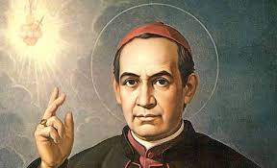
POEM LINES
He was found by the Bureau of Statistics to be
One against whom there was no official complaint,
And all the reports on his conduct agree
That, in the modern sense of an old-fashioned word, he was a saint,
For in everything he did he served the Greater Community.

Slide 8
Except for the War till the day he retired
He worked in a factory and never got fired,
But satisfied his employers, Fudge Motors Inc.
Yet he wasn't a scab or odd in his views,
For his Union reports that he paid his dues,
(Our report on his Union shows it was sound)
And our Social Psychology workers found

Slide 9
That he was popular with his mates and liked a drink.
The Press are convinced that he bought a paper every day
And that his reactions to advertisements were normal in every way.

Slide 10
Policies taken out in his name prove that he was fully insured,
And his Health-card shows he was once in hospital but left it cured.
Both Producers Research and High-Grade Living declare
He was fully sensible to the advantages of the Instalment Plan

Slide 11
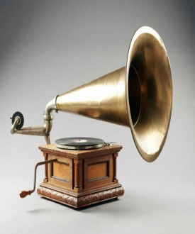
And had everything necessary to the Modern Man,
A phonograph, a radio, a car and a frigidaire.
Our researchers into Public Opinion are content
That he held the proper opinions for the time of year;
When there was peace, he was for peace: when there was war, he went.
He was married and added five children to the population,

Slide 12
Which our Eugenist says was the right number for a parent of his generation.
And our teachers report that he never interfered with their education.
Was he free? Was he happy? The question is absurd:
Had anything been wrong, we should certainly have heard.

Slide 13
THE END

